Slide 1
ORGANIZING FOR BUSINESS ANALYTICS PLATFORMS
GROUP PROJECT PRESENTATION ON UNIVERSITY DATA DESIGN
ANANYA CANAKAPALLI - AXC230004
MANISHA VARMA - MXV220022
ROHITH ANIL NAIR - RXN220027
SAI KALYAN MAMILLAPALLI - SXM220112
SAURABH DAS NAIR - SXN220009
YASHASWINI BORE GOWDA - YXB220019

Slide 2

CURRENT SCENARIO
Hybrid Data Infrastructure
Diverse Application Landscape
Recent Course Additions
Competing Local Universities
CHALLENGES
Outdated Infrastructure
Data Reconciliation Issues
Budgetary Constraints
Data-Driven Deficiency

Slide 3
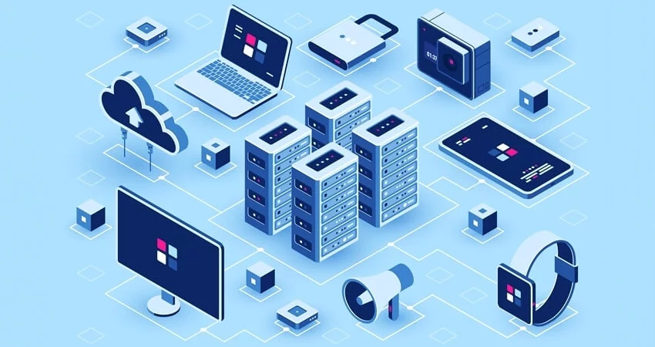
STRATEGIC UNIVERSITY OBJECTIVES
Predictive Analytics for Student Support
Data Reporting Enhancement
Data Security and Governance
Seamless Data Integration
Centralized Data Repository
Analytical and AI-Driven Model
Cost-Efficient Scalability

Slide 4
Scalable and Secure Data Platform for UT Dallas
Business Needs to be met
Improved Decision-Making
Enhanced Operational Efficiency
Advanced Research and Analytics
Architectural Principles to be followed
Scalability and Flexibility
Security and Compliance
Integration and Interoperability
Cost-Effectiveness
Recommend Technology stack
Cloud-based Storage
Data Lakehouse Approach
Open-source Tools
Industry-standard Security Protocols

Slide 5

Overcoming Roadblocks to Data-Driven Success
Data Integration
Data Security
User Adoption
Technical Expertise

Slide 6
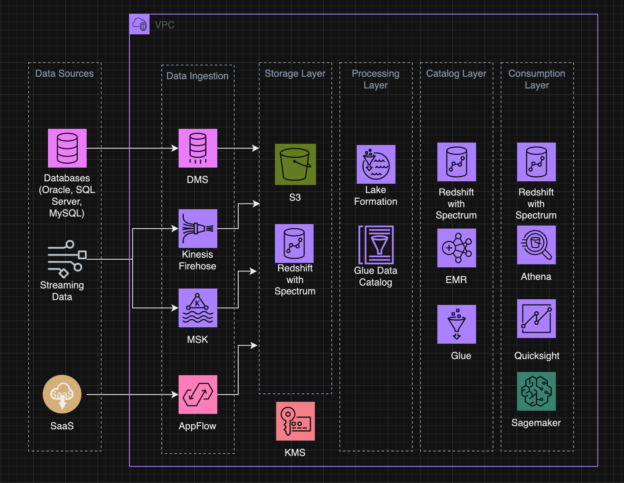
Data Lakehouse Architecture

Slide 7
Security
Authentication and Authorization Mechanism - IAM roles and policies - Principle of Least Privilege
Data Protection and Encryption Mechanism - Data Masking ,Macie, KMS and Secrets Manager
Governance and Control Mechanism- Cloud Trail and Cloud Watch
Network Security - VPC to achieve network isolation, VPN endpoints
S3
Bucket policies and Access Control Lists
User-based security through IAM policies, specifying allowed API calls for specific users
MFA delete
EMR
Two EC2 Security Groups - one for master node and one for cluster node
In-transit encryption
Quicksight
MFA enabled
Limited permissions
Row level security and column level security
Glue
Access databases with JDBC through SSL to enable encryption while connections from glue to databases are initiated
Redshift
Secure data in transit using TLS between Redshift and S3 as well as JDBC connections

Slide 8
AWS Tools for Data Analytics:
AWS Redshift for SQL analytics and Redshift Spectrum for ad-hoc analysis.
AWS Athena for serverless querying without upfront infrastructure provisioning.
Decision-Making with Analytical Data Models:
Redshift's role in building structured frameworks.
Integration with AWS SageMaker for machine learning and AI models.
DATA ANALYSIS & VISUALIZATION

Slide 9
Detailed Dashboards for Users:
Overview Dashboard for students.
Teaching Dashboard for faculty.
Enrollment Management Dashboard for administrators.
Visualization Techniques:
Interactive charts, graphs, and geographical maps.
Drill-down functionality for detailed exploration.
User Interaction Features:
Intuitive user interface with filter options.
Automated alerts and notifications for critical events.
Export functionality in various formats (CSV, Excel).
Business Intelligence Tools:
Tableau, Power BI, and Amazon QuickSight can be integrated with Redshift.
Looker for collaborative analysis and defining business metrics.
Predictive Modeling and AWS Tools:
SageMaker for developing machine learning models.
AWS Lambda for real-time integration and preprocessing.
Data Visualization with Amazon QuickSight:
Embedded analytics for applications and portals.
Mobile compatibility for on-the-go access.

Slide 10
CONCLUSION
Lake House Advantage:
Facilitates rapid insights across all data types.
Enables future-proofing for evolving analytic technologies.
AWS Service Flexibility:
Purpose-built services for each layer ensure adaptability.
Demonstrated flexibility and rich capabilities for optimal use.
Comprehensive Resources:
Explore detailed patterns, walkthroughs, and code samples.
Topics include ETL/ELT design, data replication, cost management, analytics with Spark, Redshift Data API, and query optimization.
Implementation Focus:
Architectural examples like ETL patterns, data replication, and cost management provide practical guidance.
Allows for seamless implementation and optimization of Lake House Architecture on AWS.

